Slide 1
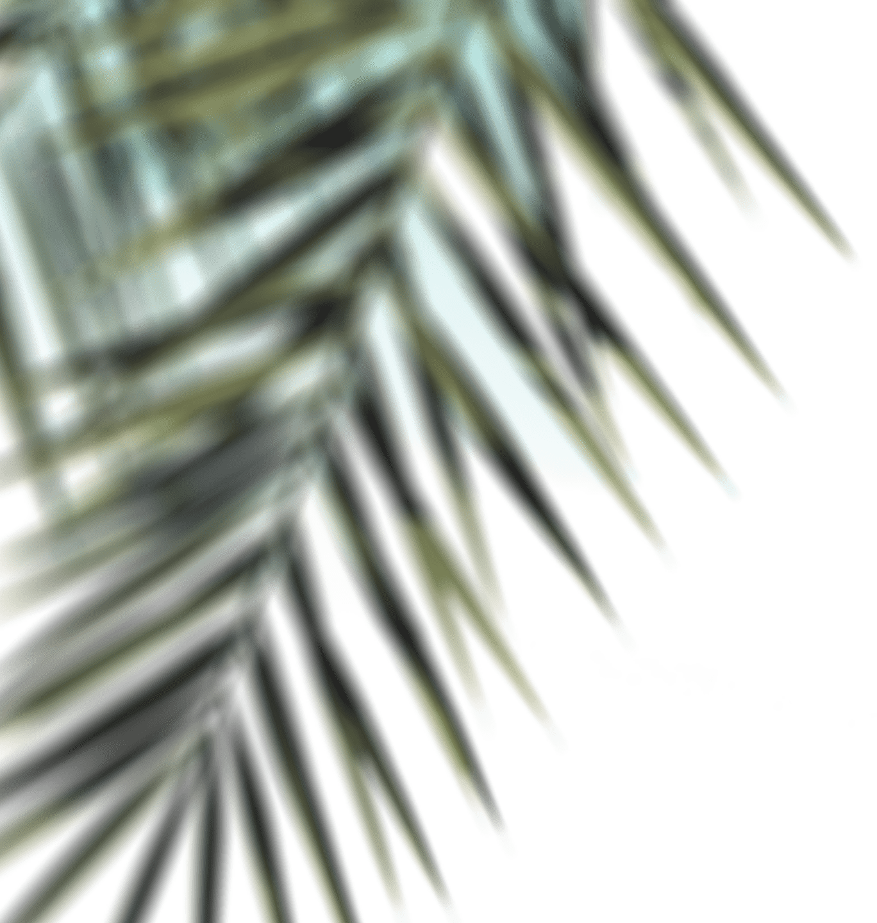

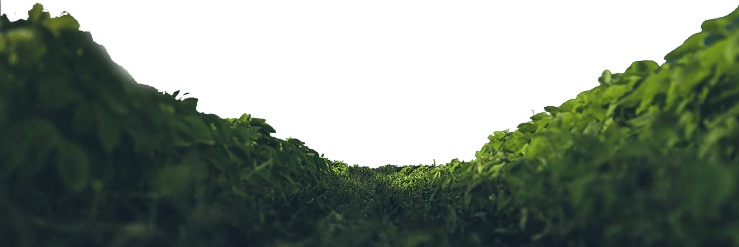
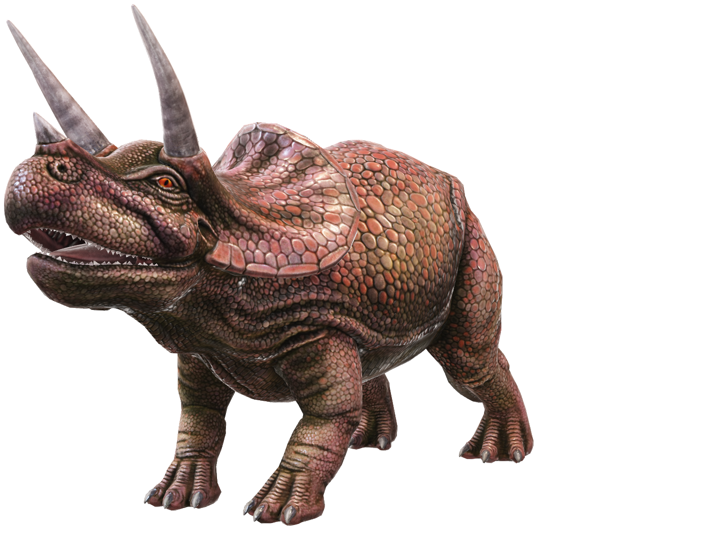
Triceratops
The Three-Horned Dinosaur

Slide 2
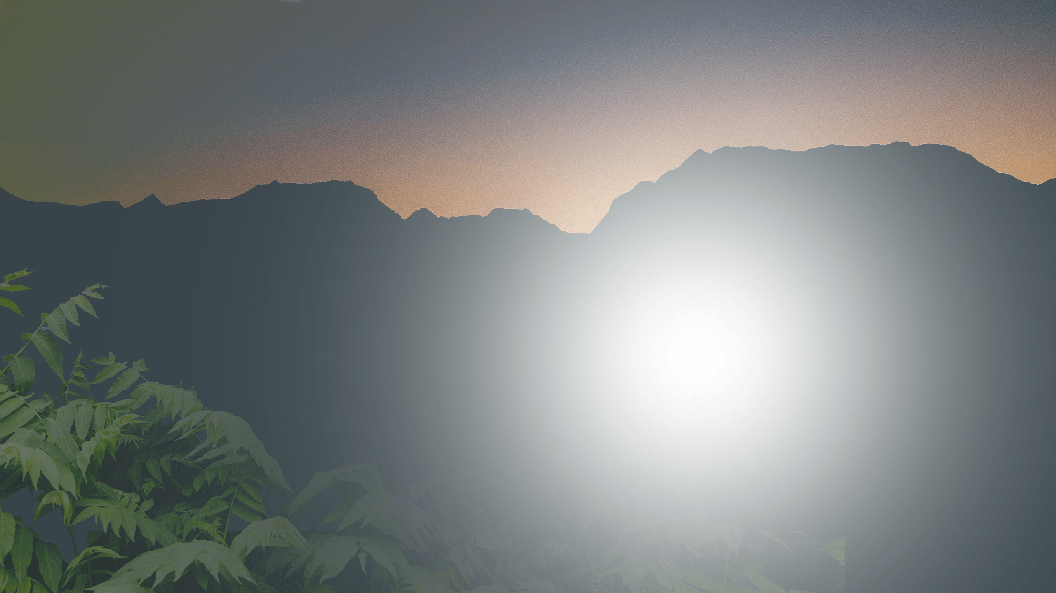




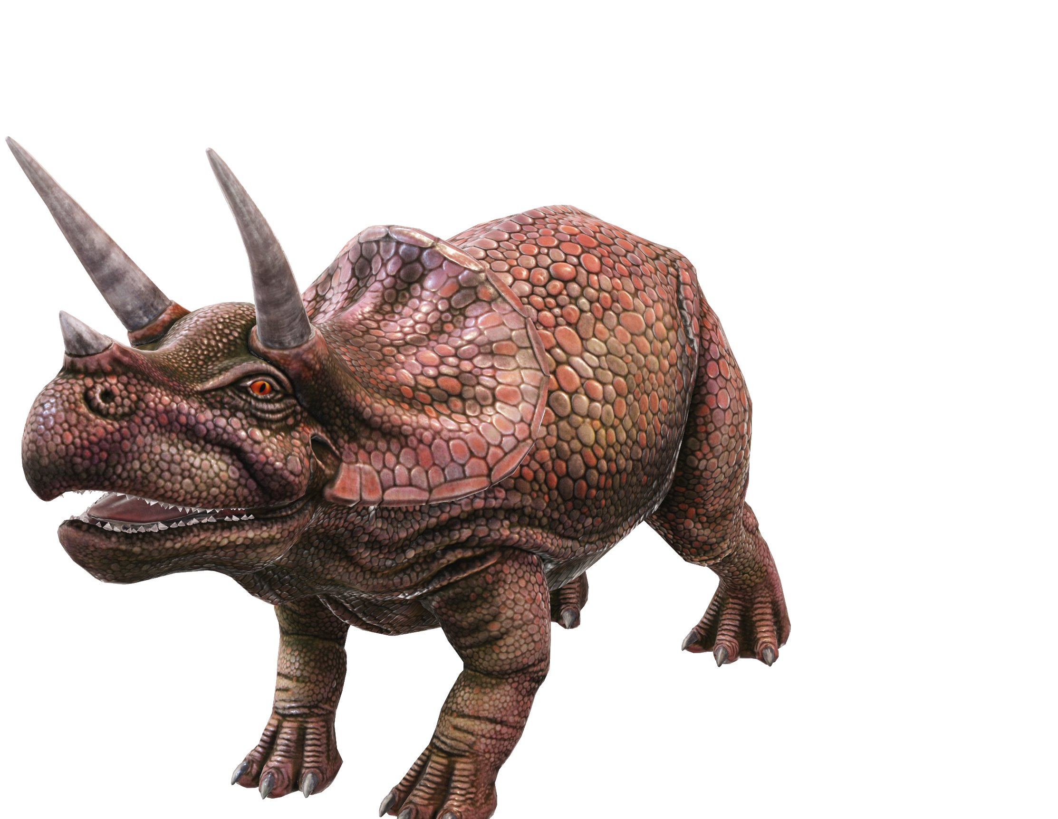
Triceratops means literally, “three horned face”
Two horns
just above the eyes and a smaller one on the snout.
The third horn
was a ‘false’ horn made of soft protein. Scientists are still unsure as to its purpose.

Slide 3
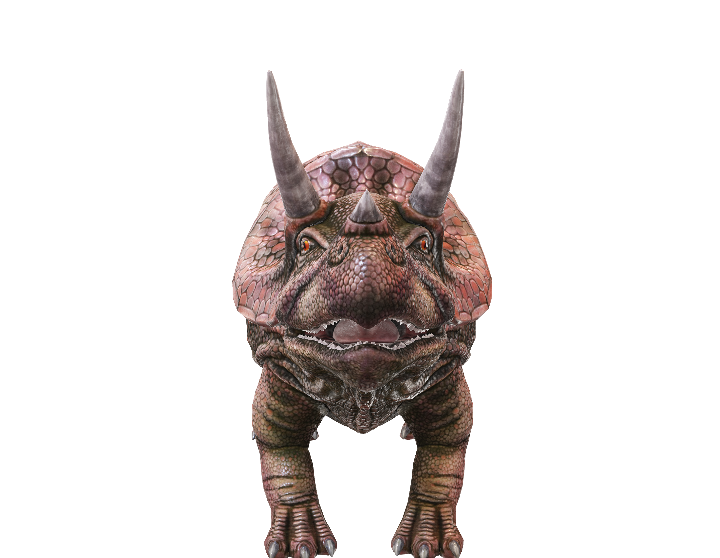
Horns And Bony Frill
Although the horns and bony frill on the large head could be, and were, used as defensive weapons,
it’s now believed they were also used for dominance displays and courtship rituals – much in the same way as deer use their antlers.

Slide 4
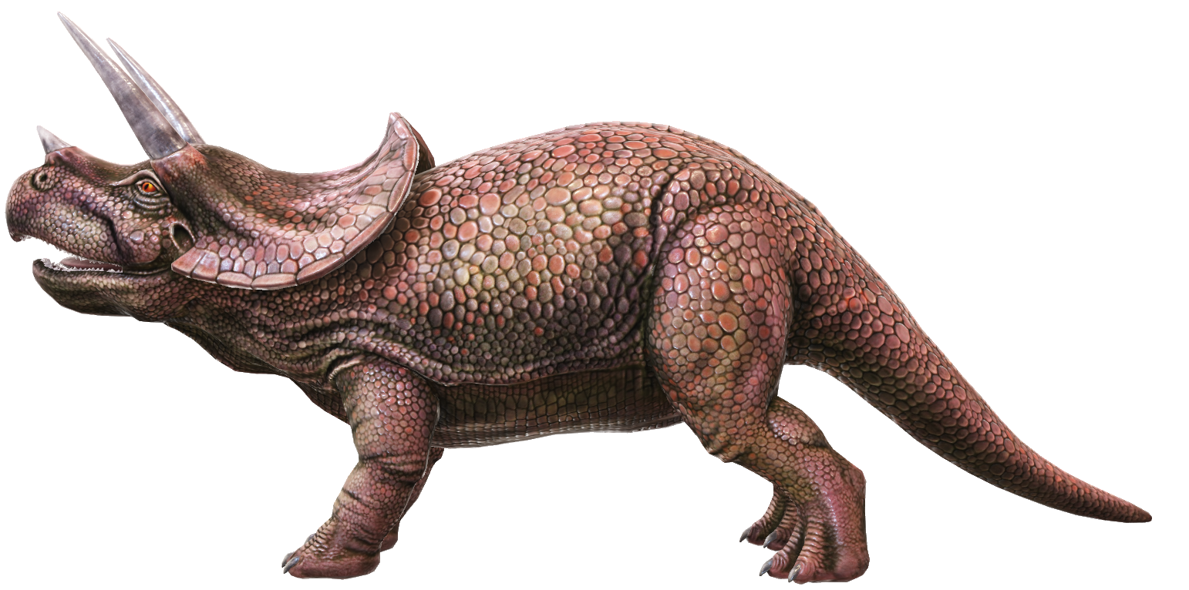
Triceratops size
Around 10 feet high, 26 feet long, and weighing in between 6-12 tons; Triceratops was no size zero!
If the average sized man could stand next to him today, he’d just about reach the base of his tail. But best mind your feet…
10 feet
26 feet

Slide 5
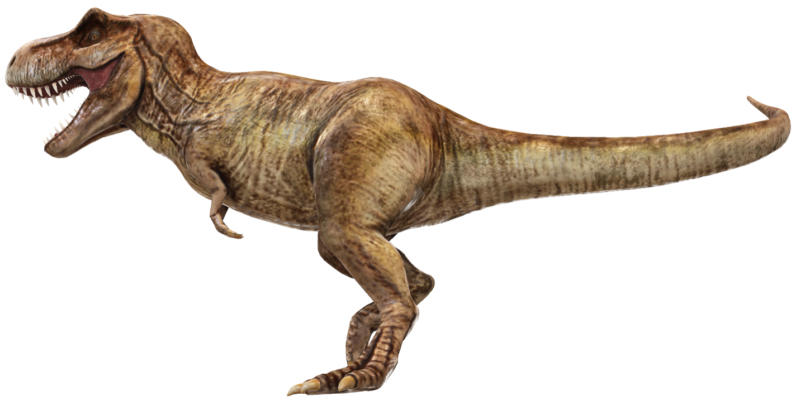

Triceratops Versus T-Rex
Size comparison between Triceratops and Tyrannosaurus Rex – around 15 to 20 feet high
15 to 20 feet

Slide 6
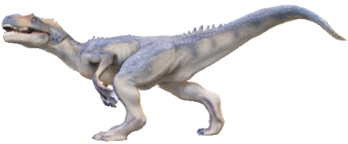

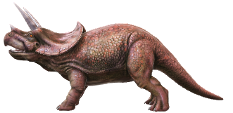
Triceratops Timeline
Triceratops roamed the Earth during the latter half of the Cretaceous period, around 65-72 million years ago.
Allosaurus
Triceratops
Triassic Period
Jurassic Period
Cretaceous Period
150
245
200
145
65
The Cretaceous ended with the most famous mass extinction in all of history; the Cretaceous-Tertiary.
Triceratops was one of the last dinosaurs to become extinct.
Mind blowing fact!
More time exists between Allosaurus in the Jurassic Period and Triceratops in the Cretaceous (83 million years) than between Triceratops and humans.

Slide 7
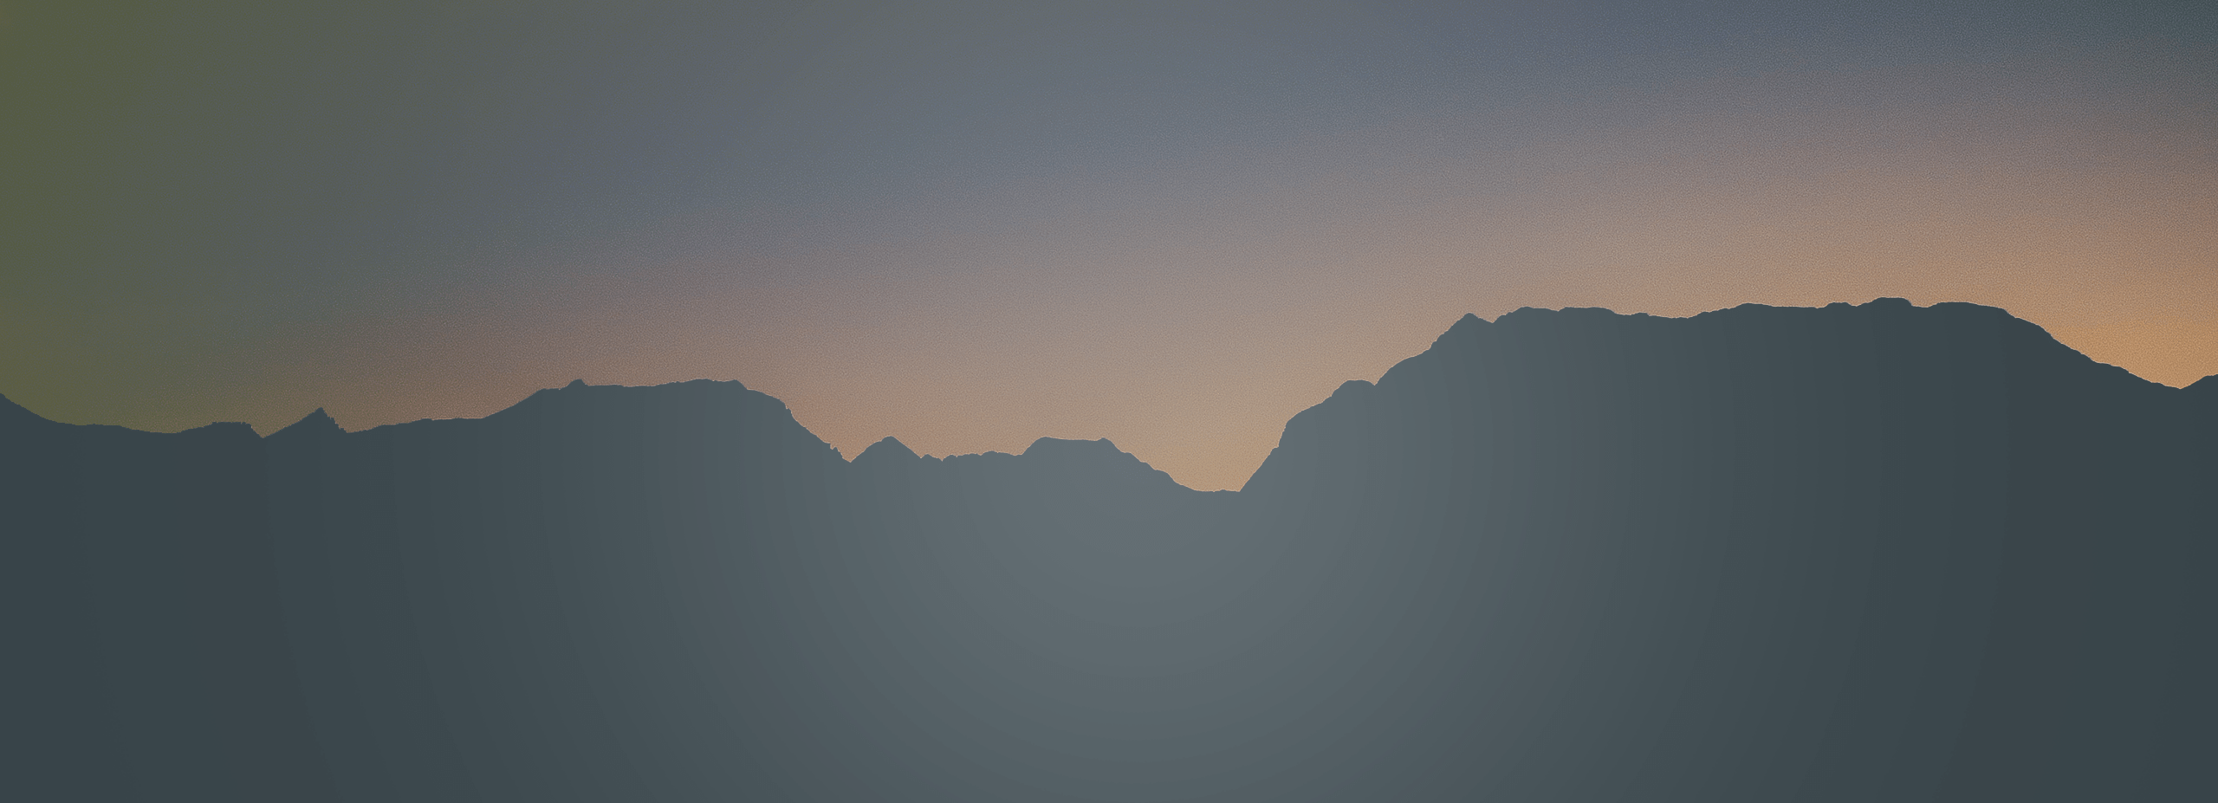




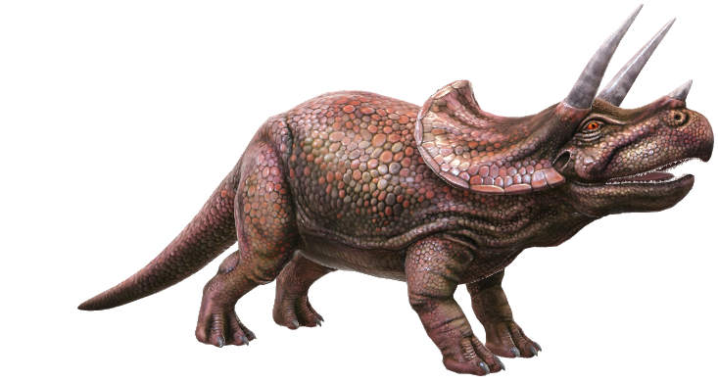
Where Triceratops Lived
Triceratops lived in parts of Western Canada and the U.S.
It liked marshy, forested areas– all the better to hide from its mortal enemy: the ferocious, T-Rex.

Slide 8
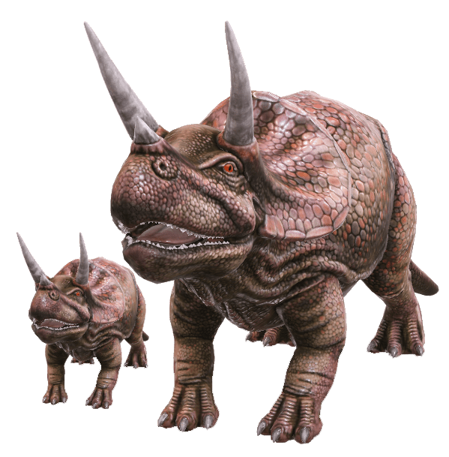
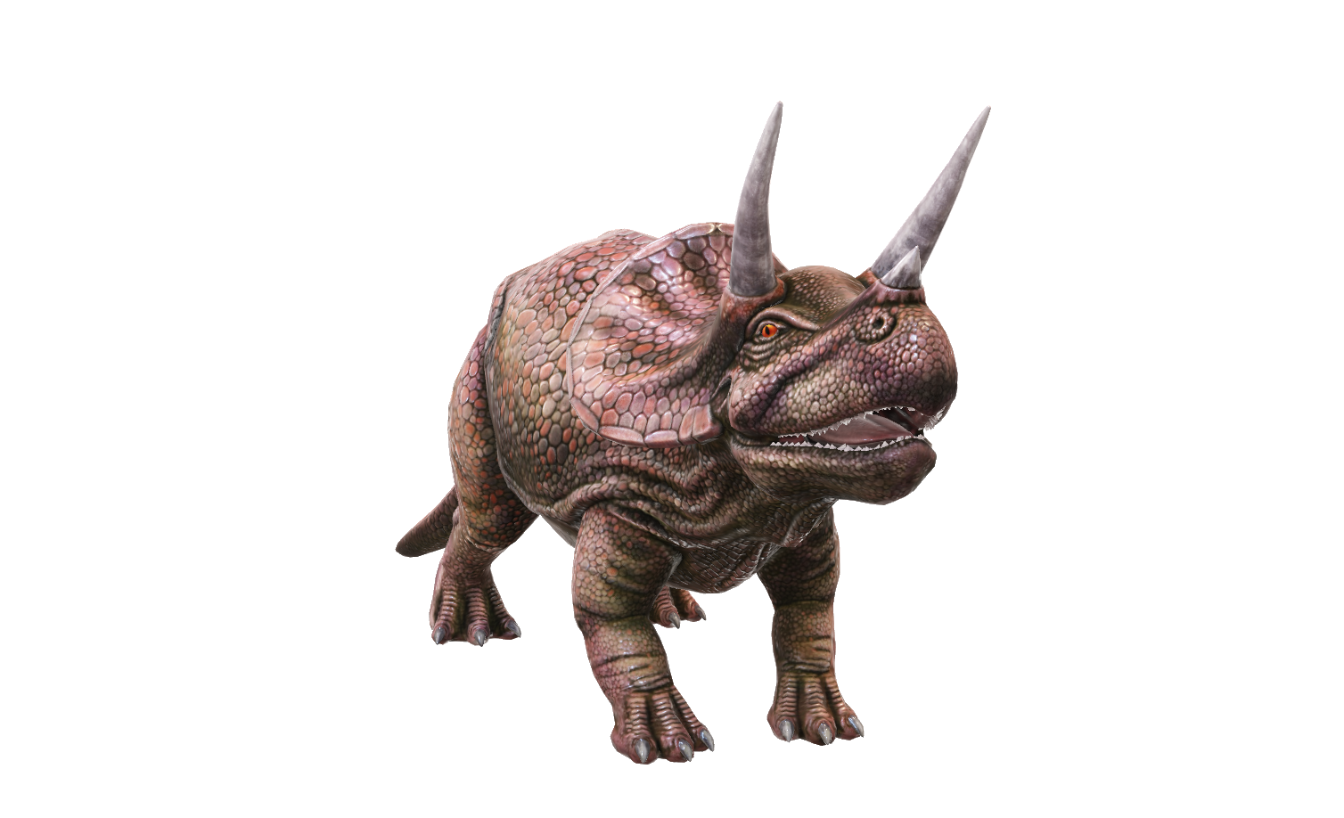
Triceratops Herds
Fossil Discoveries
The most recent fossilized discoveries suggest that Triceratops congregated and travelled in small groups, especially as juveniles, perhaps with their families.
There’s little evidence to show they lived in large herds.

Slide 9
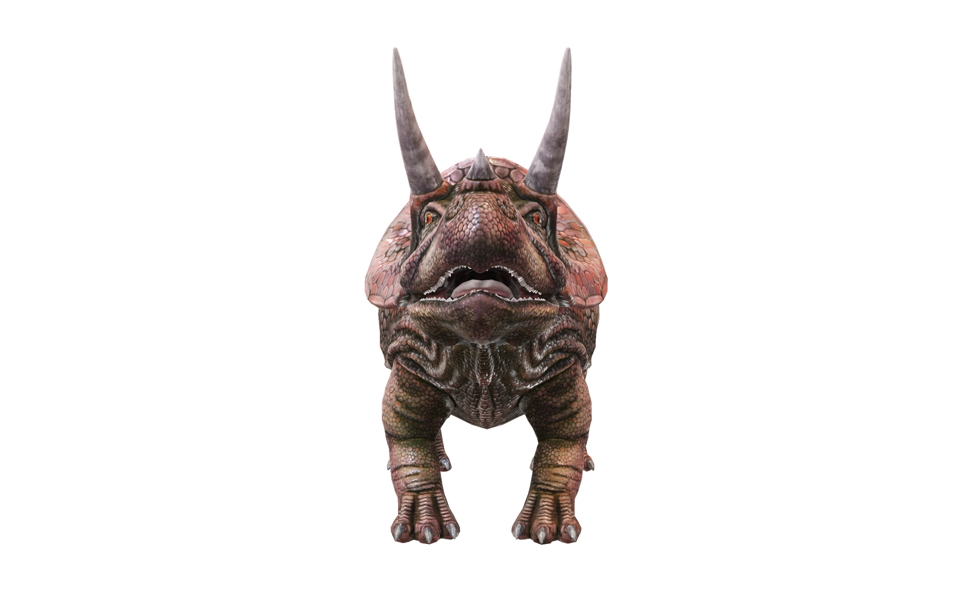
A Dentist's Nightmare
Triceratops Teeth
Triceratops teeth are one of the most complex of all animals that have ever lived.
Comprising 5 layers, and up to 40 ‘batteries’ (columns) on each side of the jaw, an adult could boast as many as 800 teeth!
These layers allowed Triceratops to munch through massive amounts of leaves, stems, and woody branches. When you weigh as much as 2 male elephants, you need a lot of food! But thankfully, they were herbivores…
The wear and tear of all this chewing was tremendous, hence so many teeth to replace ones that got damaged over time.

